Slide 1

Dawood University of Engineering & Technology
ARAB INVASION OF SINDH 711-715 AD.
Lecture # 2

Slide 2
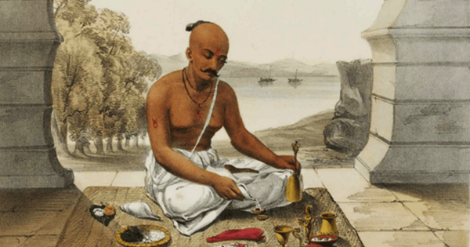
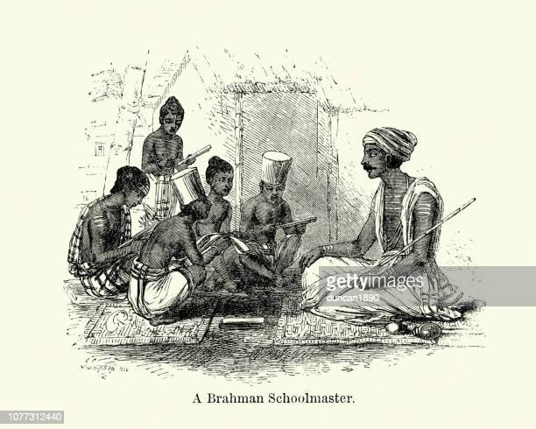
SINDH BEFORE ISLAM:
The caste system in ancient India was a social and religious system that divided people into four main castes, each with its own specific duties and privileges. The four castes were:
Brahmins: This was the highest caste, made up of priests and scholars who were responsible for performing religious rituals, studying and teaching the Vedas (sacred texts), and providing guidance to the rulers. Brahmins were believed to be the most spiritually pure and were accorded the highest respect in society.
There are four Indo-Aryan Vedas: the Rig Veda contains hymns (Mantars) about their Mythology; the Sama Veda consists mainly of Hymns about religious rituals; the Yajur Veda contains instructions for Religious Rituals; and the Atharva Veda consists of spells against Enemies, Sorcerers, and Diseases.

Slide 3
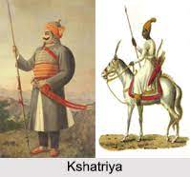
Kshatriyas: This caste was made up of warriors and rulers who were responsible for protecting society and maintaining law and order. Kshatriyas were expected to be brave, skilled in warfare, and committed to upholding the dharma (righteousness) of society.

Slide 4
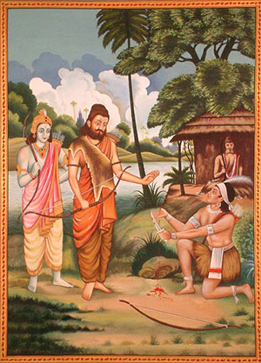
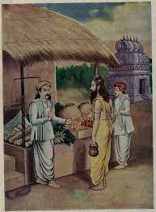
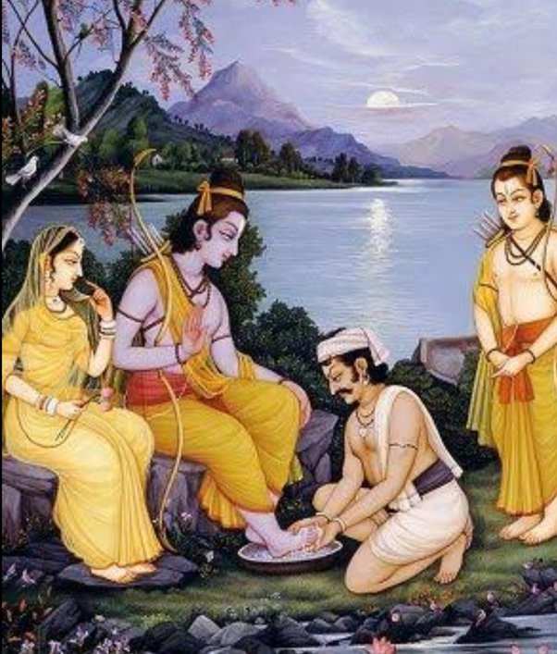
Vaishyas: This caste was made up of merchants, traders, and farmers who were responsible for producing and trading goods. Vaishyas were expected to be skilled in business and agriculture, and to contribute to the wealth of society.

Slide 5
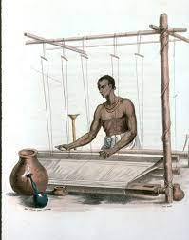
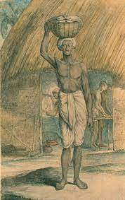
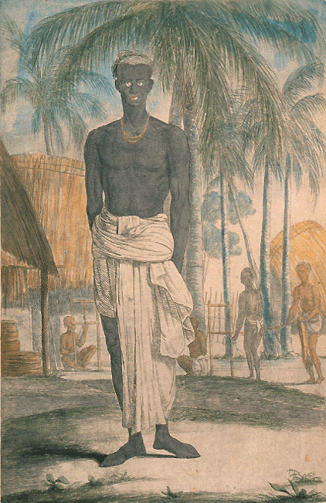
Shudras: This was the lowest caste, made up of laborers and servants who performed manual labor and menial tasks. Shudras were expected to serve the higher castes and were not allowed to participate in religious or political activities.

Slide 6

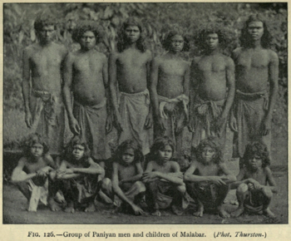
There was also a group of people known as the untouchables, who were considered to be outside the caste system altogether. They were relegated to the lowest of the low and were responsible for performing tasks that were considered to be ritually impure, such as cleaning sewers and disposing of dead animals.
The caste system was based on the principle of karma, which held that a person's social status was determined by their actions in past lives. While the system was intended to provide order and stability to society, it also reinforced inequality and discrimination, with members of lower castes being denied access to education, political power, and social mobility.

Slide 7
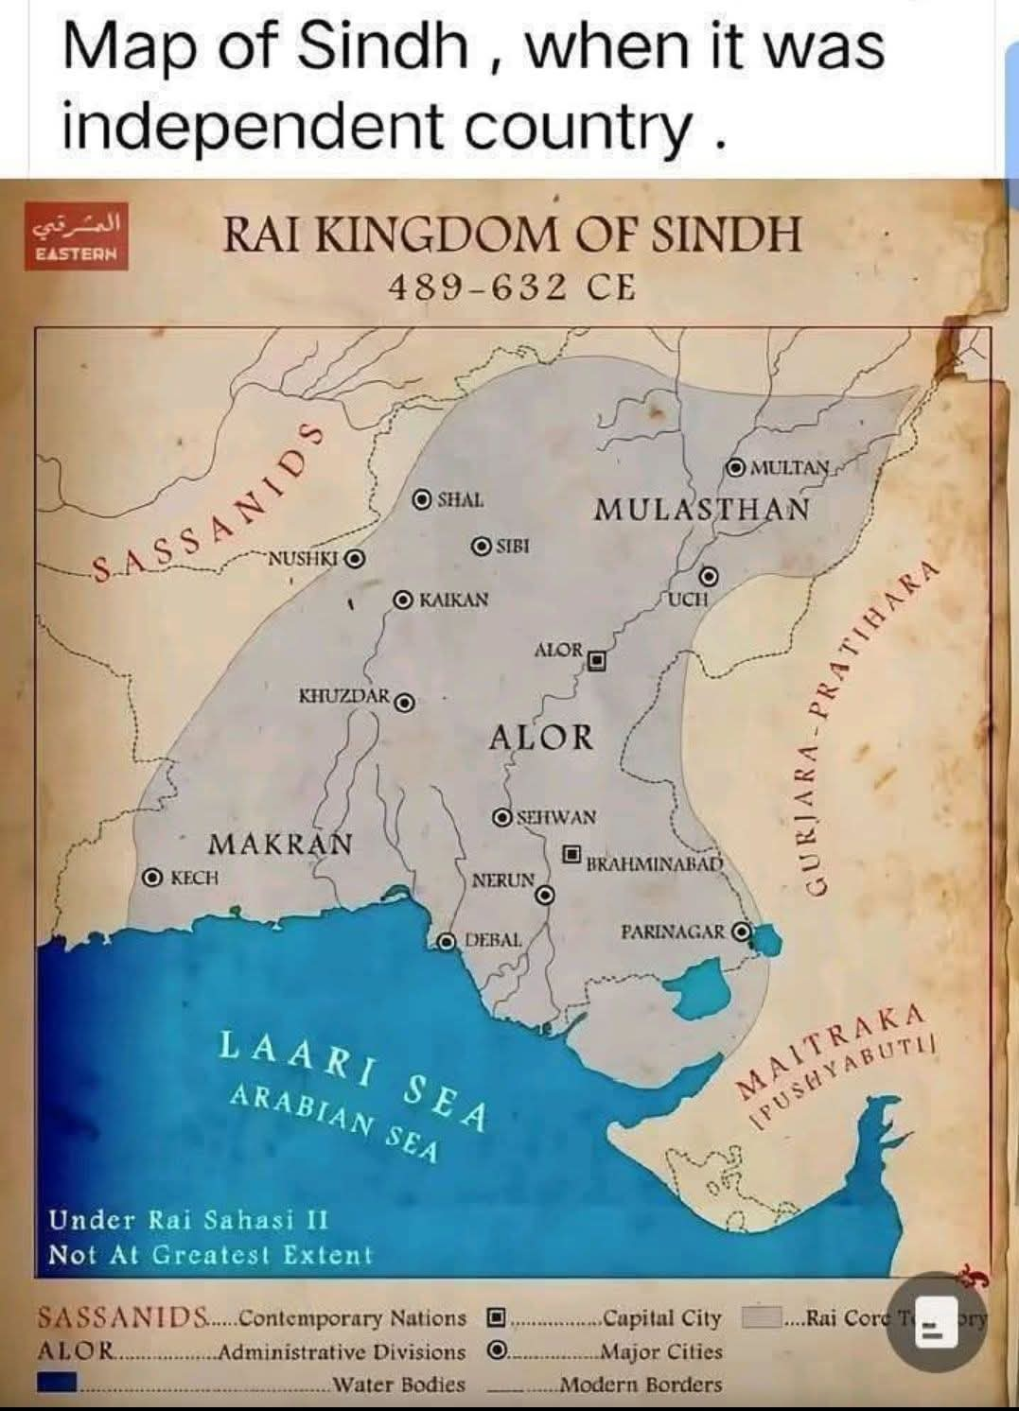
ARAB INVASION OF SINDH 712 AD.
Before Islam:
Ray family ruled on Sindh almost 137 years. It’s founder was Raja Ray Dewach and last ruler was Raja Ray Sahasi.
Raja Ray Sahasi has a Minister, his name was Raam. With the passage of time a Brahman, Chach bin Sailaj meet with Raam.
Chach bin Sailaj inspire to Raam as well as Raja Ray Sahasi.
After the death of Raam Chach bin Sailaj became minister of Raja Ray Sahasi.
After the death of Raja Ray Sahasi, Chach maariged with his wife as well as succeeded Raja of Sindh.
Raja Chach ruled (633-660). His wife name was Rani Soanh Devi. He has two sons; Raja Dahar Seana & Raja Dahir as well as Daughter Rani Maeen.

Slide 8
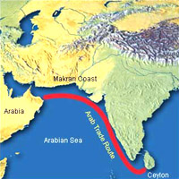
ARABS:
At the time of Sindh Annexation there was Umayyad Family rolled on Arabs. Walid bin Abdul Malik was Caliph of Umayyad Dynasty on that time.
Their capital was Damascus Syria, more than 4000km away from Sindh
Before the birth of Islam Arabs Contact with this region in the face of Arab Traders/Sailors.
In 644 A.D. the first Muslim expedition to the Subcontinent through Balochistan to Sindh.
The Arab send report by the leader of expedition stated that; Water is scarce, the fruits are poor & the robbers are bold, if few troops are send they will be killed, if many are send they will die of food scarcity.

Slide 9
CAUSES OF ARAB INVASION OF SINDH:
The Arab invasion of Sindh in the 8th century CE was a significant event in the history of the Indian subcontinent, and its causes have been the subject of much scholarly debate.
Several historical sources provide insights into the reasons behind the invasion.
Due to strict policy of Hijjaj and the governor of eastern provinces, Muhammad Lafi (anti- Hijjaj element) took shelter with his 500 Companions in the land of Sindh (kingdom of Raja Dahir). (Chachnama by Dr. Nabi Bux Baloch)
Raja Dahir not only allowed a Muslim chieftain to take refuge who had murdered a Muslim governor of eastern province (Iraq), but also gave him an important position in his army.
Due to some circumstances Raja Dahir Married with Sister Maeen (though only symbolically). The Citizen of Sindh were not happy with such a kind of act of Raja Dahir, & wrote a letter to Muslim governor of Iraq (Al-Hijjaj bin Yousuf).
Sindh had been a part of the Sasanid Empire of Persia ( 633–654) which was now captured by the Muslims, so Muslim considered Sindh a part of their empire.

Slide 10
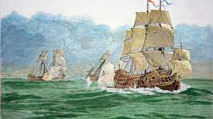
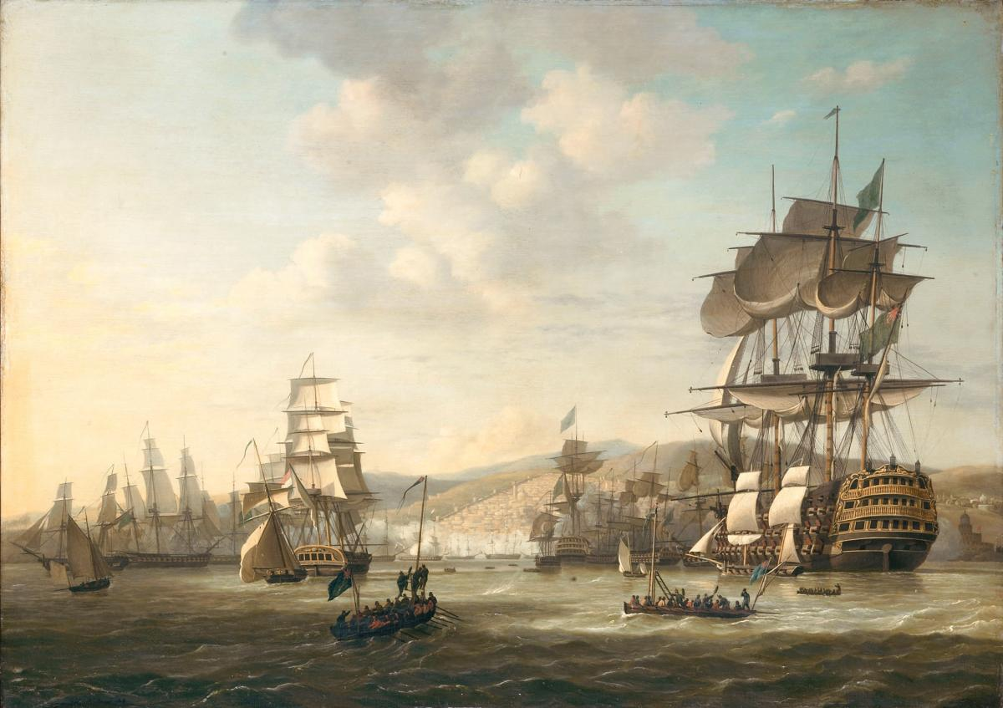
The immediate cause of the Arab invasion of Sindh was the looting of the eight Arab ships by some Pirates of Maid Tribe, which carried the gifts and treasures sent by the king of Ceylon to the Caliph, at the port of Debal near Sindh. Some Historians have opined that the ships were also carrying some beautiful women as well as valuable articles for the khalifa. This unlawful act of piracy was strongly protested by Hijjaj, the governor of Iraq.
Hijaj wrote a letter to Raja Dahir:
He demanded compensation from Raja Dahir, to return all the things & people as well as gave the punishment those who involved.
But Dahir refuted Hijjaj’s demands by saying that: “He had no control over pirates, and they note came under my Kingdom.”
This infuriated Hijjaj who decided to send military expeditions to Sindh. He also obtained permission from the Caliph in this regard.

Slide 11
Hijjaj was wise politician and never were his decision based on pure emotions. He always decided after carefully assessing the pros & cons. To him live of few people had no importance. So his decision to invade Sindh was not to help the helpless women and children but to get political and economic benefits or stability. (In the Shadow of the History by Dr. Mubark Ali)
However, the first two expeditions sent by Hijjaj under the leader ship of Budhail ibn Tehfatah & Ubeydullah bin Nahban against Sindh were beaten back by Raja Dahir.
Enraged at the repeated failures, Hijjaj sent his nephew as well as Son-in-law Imaduddin Muhammad- bin-Qasim at the head of a huge army to Sindh. Muhammad-bin- Qasim was an able and young commander-in-chief.

Slide 12
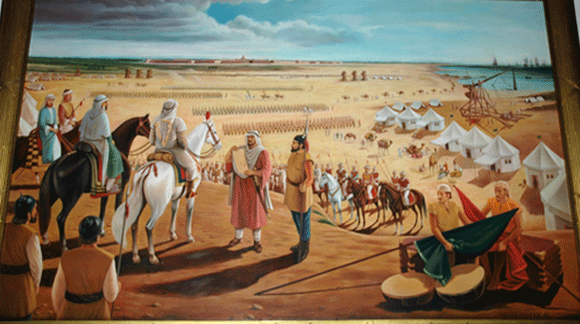

ATTACK OF MUHAMMAD BIN QASIM
In 711 A.D. a serious attempt was made by Arabs under the command of Imaduddin Muhammad bin Qasim to Capturing Sindh.
His Army Consist of 6000 Syrian Horses and 6000 Iraqi camels as well as 3000 camels carry necessary goods with Bin Qasim’s. These all came the Bin Qasim by Land.
Al-Hijjaj also send five catapult (Manjainiks) by sea, and each Manjainiks has 500 soldiers. Among them Uroos was one of them Manjainik. Its rider name was ‘Joona Salemi’.
Muhammad bin Qasim’s Army Sieging the Debal almost 8 days, he not attacked on Debal till received message from Al-Hijjaj

Slide 13
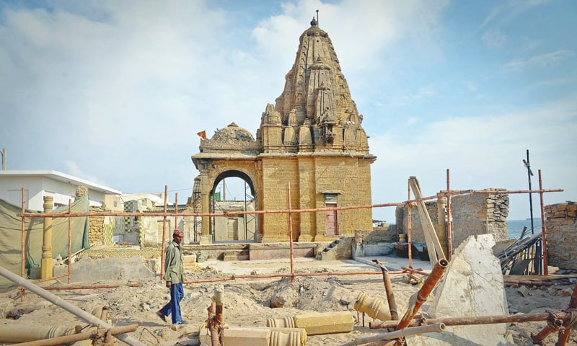
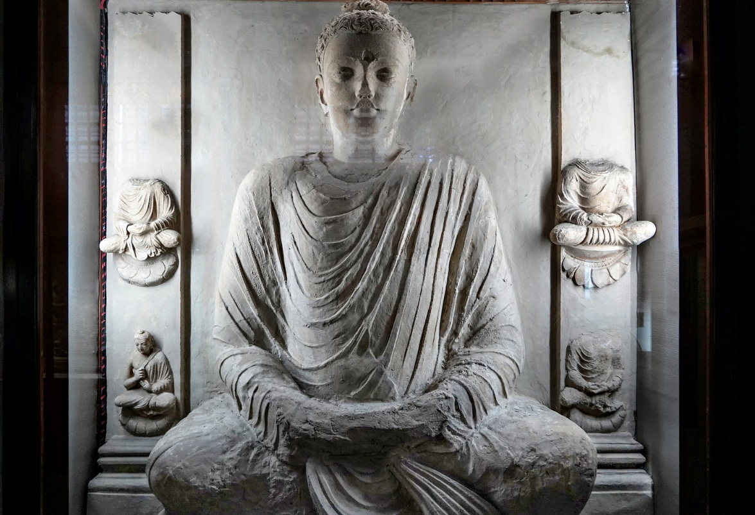
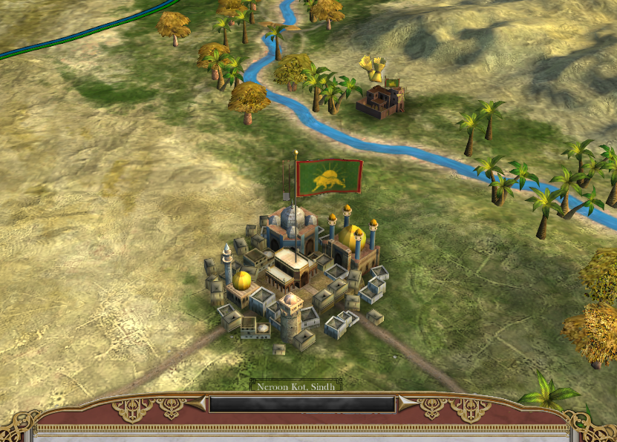
M. bin Qasim’s first attack was not succeed, and people of Debal fought with courage.
In the centre of Debal city there was a Temple, which almost 120 feet height. In the centre of Temple, above the minar red flag.
There were so many rooms in Temple, and also many Sculpture, among them Gautam Bhuddah’s Sculpture was biggest.
There was a faith of Debal’s people that the flag will cover them from invaders.
The whole story informed by a Brahman of Debal to bin Qasim.

Slide 14
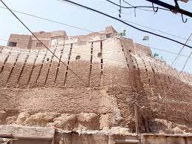
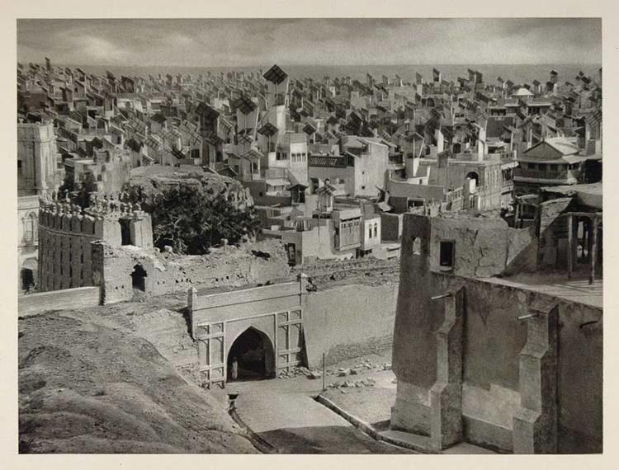
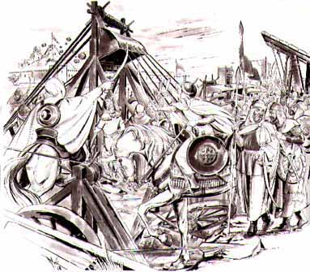
After the conquered Debal City M. bin Qasim Moved Neroon Kot (Hyderabad). The people of Hyderabad welcome to Arabs without and opposed.
When no one opposed him in Nerron Kot, he Gave them same highest administration positions.
Such act of bin Qasim angred to Al-Hijjaj, and Al-Hijjaj wrote a letter with anger, and asked to send Mal-e-Ganimat.

Slide 15
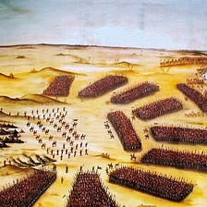

After the receiving the letter from Al-Hijjaj , Muhammad bin Qasim moved Rawar Kot , (currently near Shidadpure or Brahmanabad).
On the eve of 10th Ramzan Muhammad bin Qasim and Raja Dahir Fought a War.

Slide 16
References:
Chachnama: Translated from the Persian by Mirza Kalichbeg Fredunbeg, 1900.
The Arab Conquest of Sindh by Muhammad Ali Qasmi, 1993.
The Chachnama and the Arab Invasions of Sindh by P. M. Holt, 1961.
The Arabs in Sind: A Study in Medieval Arab History by G. M. Syed, 1950.

